Slide 1
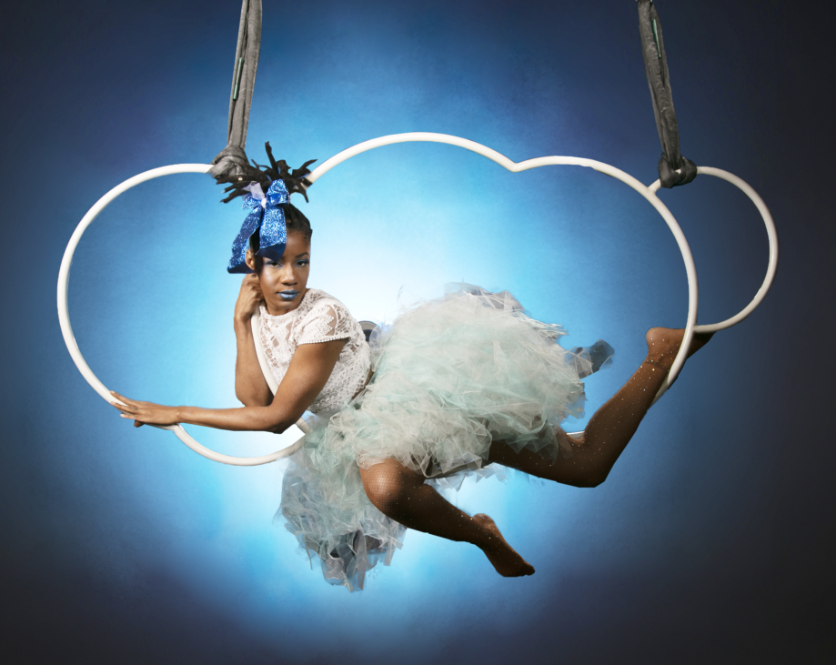
We make magic out of metal

Slide 2


Slide 3
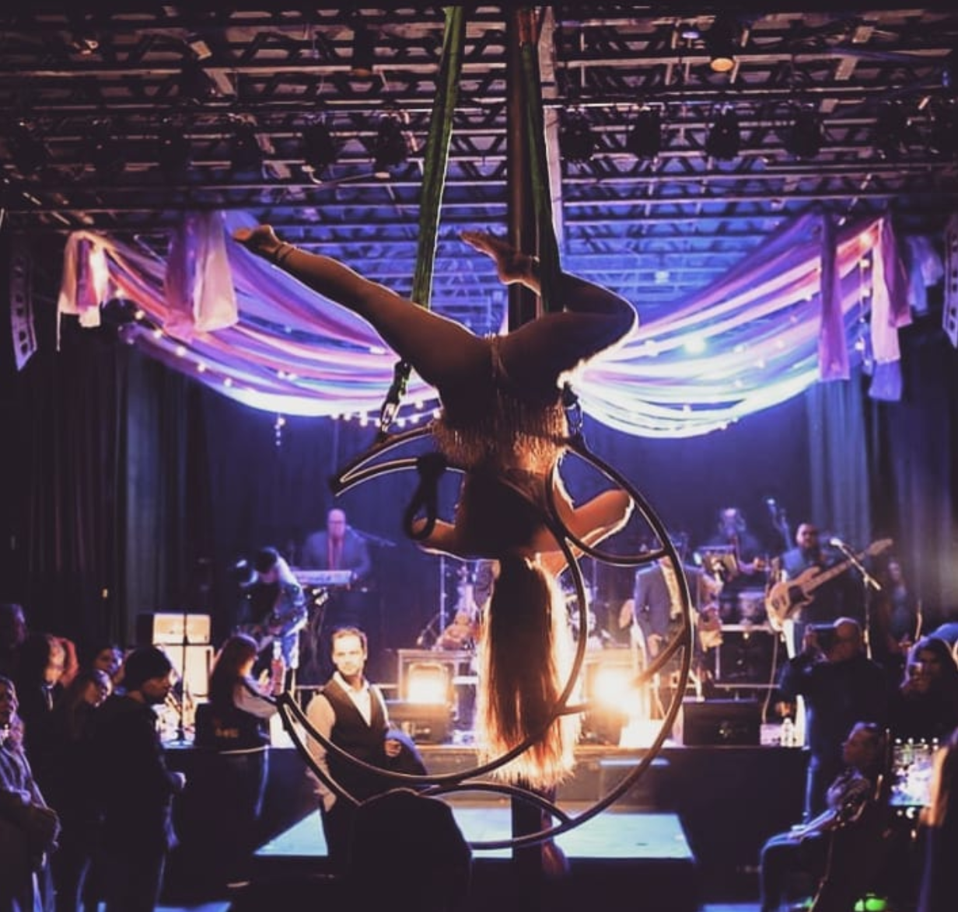
Imagination.
Dreams.
Storytelling. Strength.
Circus.
Photo by clint searcy

Slide 4
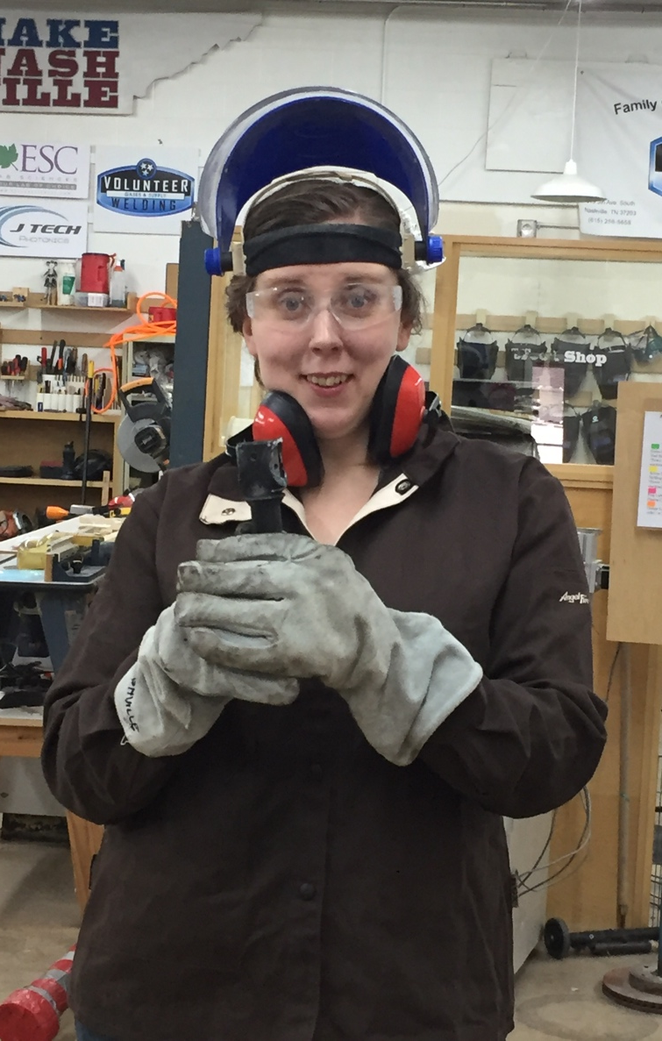
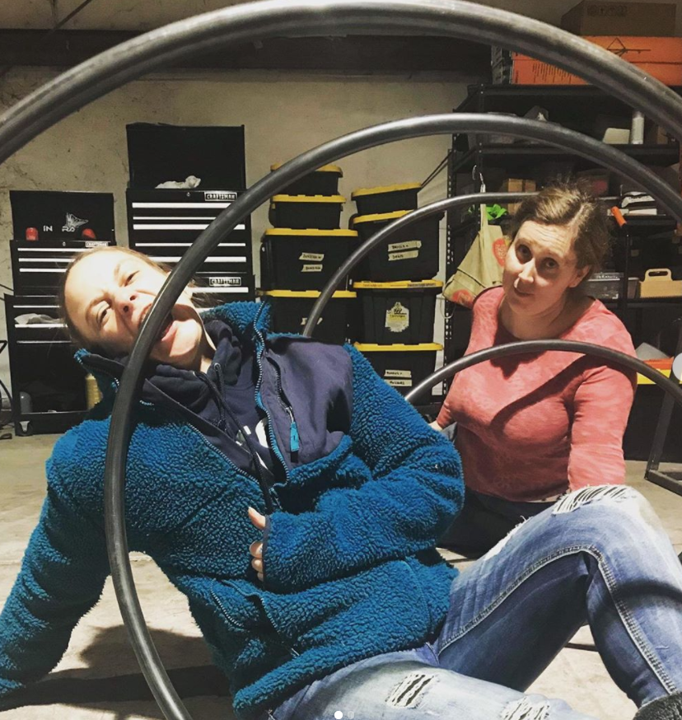
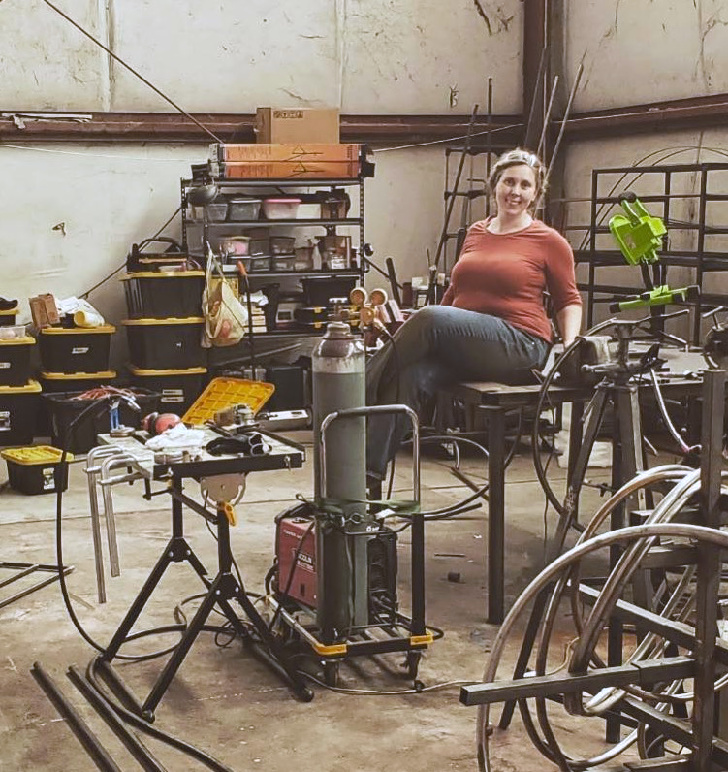
PROTOTYPING INCUBATOR
SHARED SPACE

Slide 5
We make magic out of metal
Photo by clint searcy

Slide 6
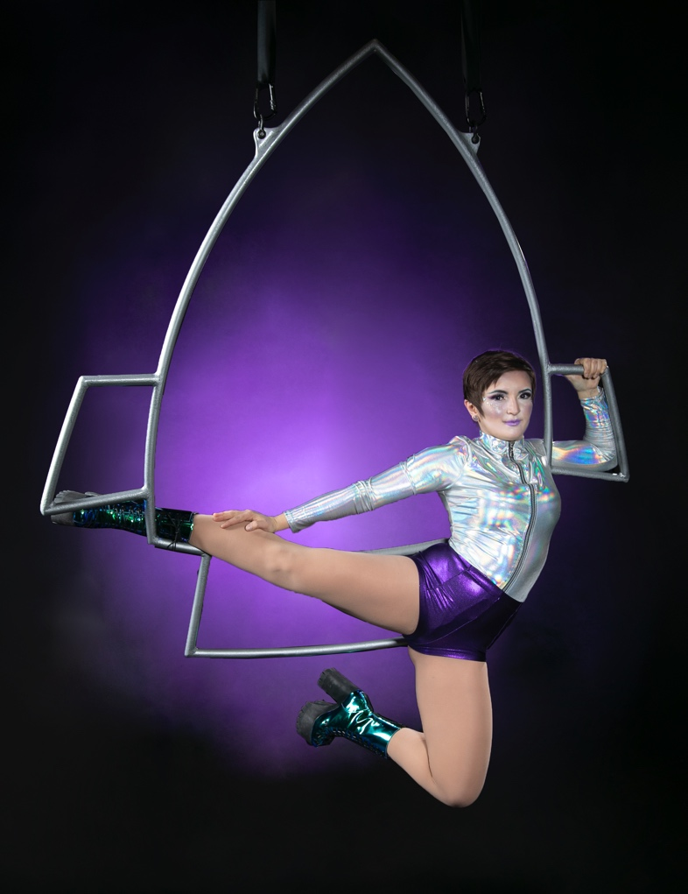
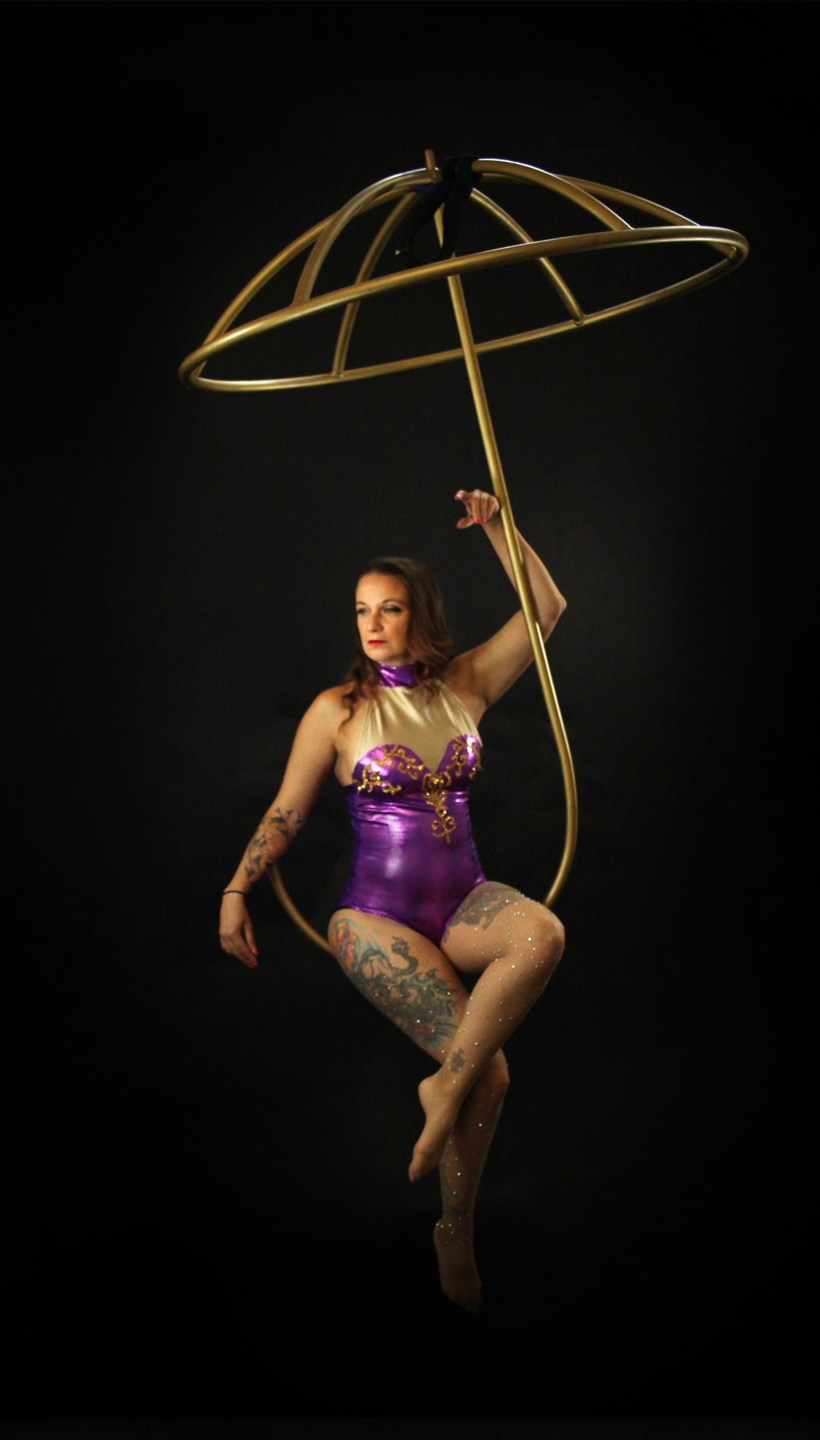
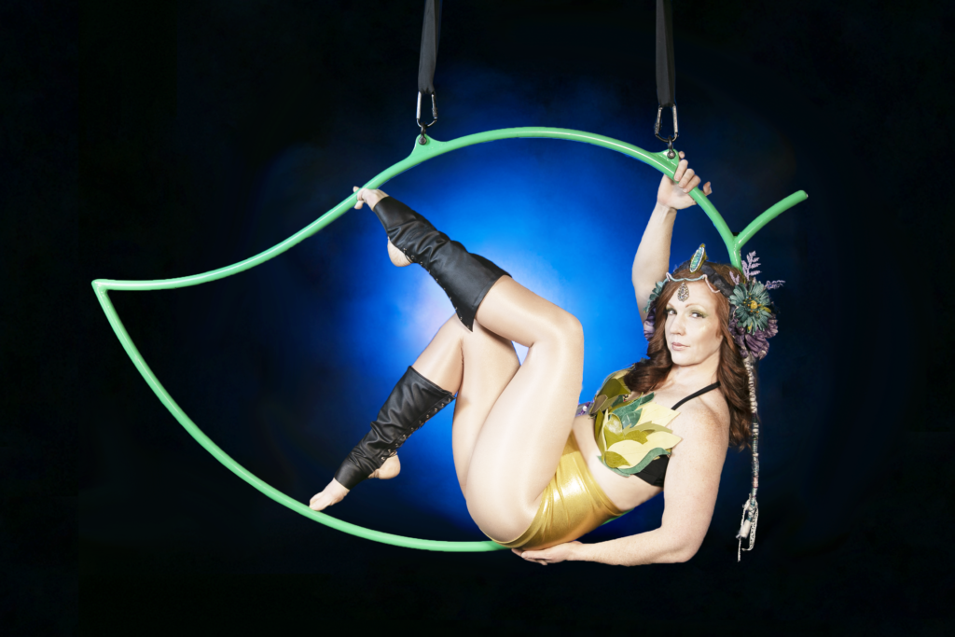
Sculpture for Dancers

Slide 7
I GOT INTO
CIRCUS ARTS
…AS A HOBBY

Slide 8
1999: A teen and her Father.
2017: Still Dad’s girl.

Slide 9
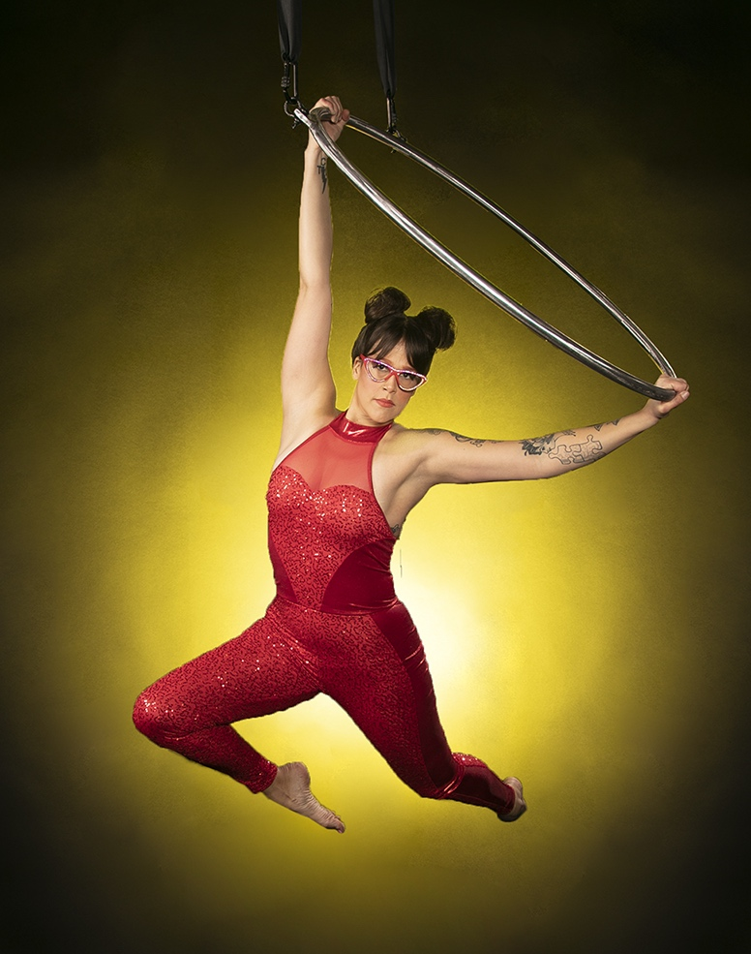
10 hoops for 10 classmates…

Slide 10
“Could you make me a Kloud?”
@luceeontheinternet

Slide 11
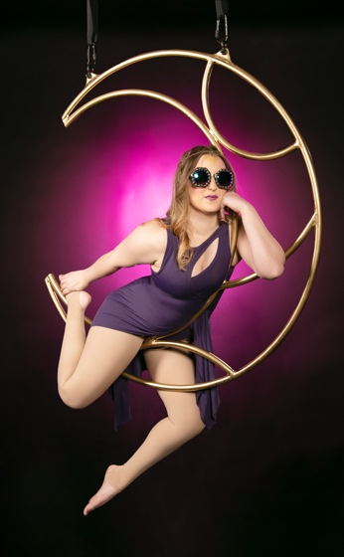
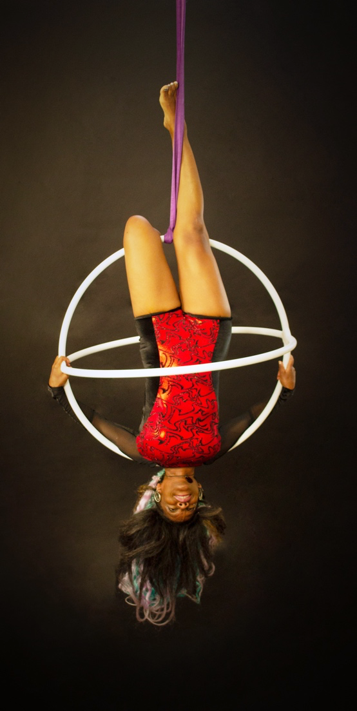
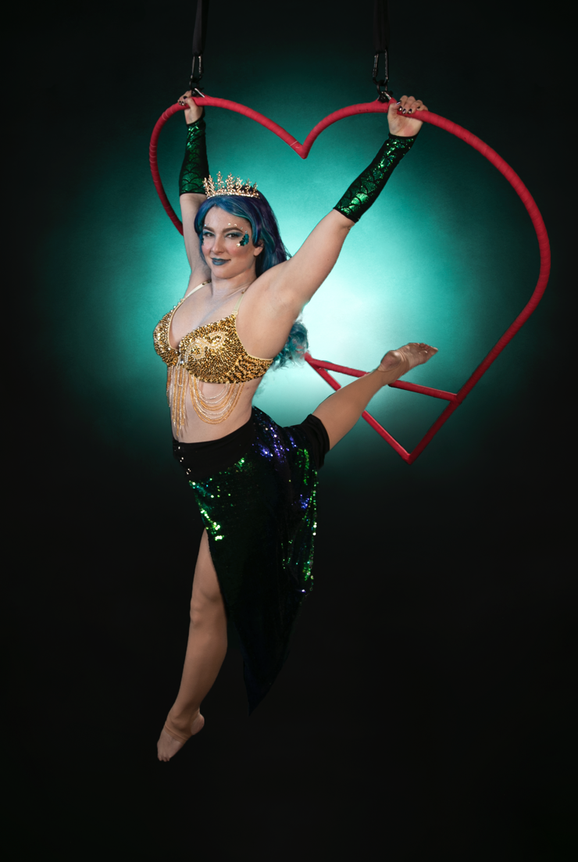
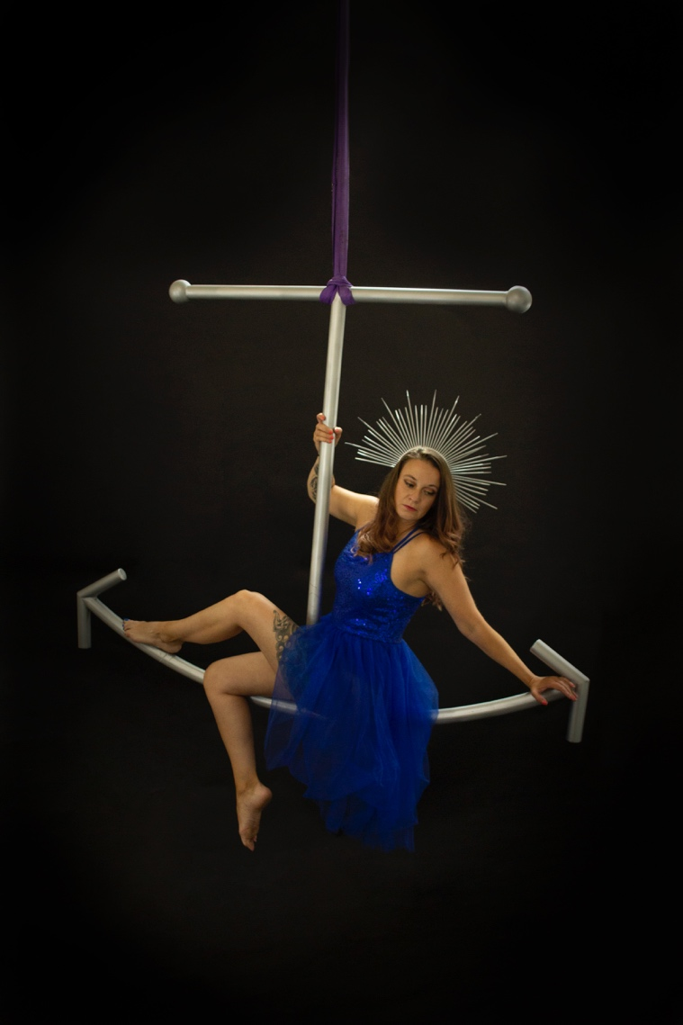
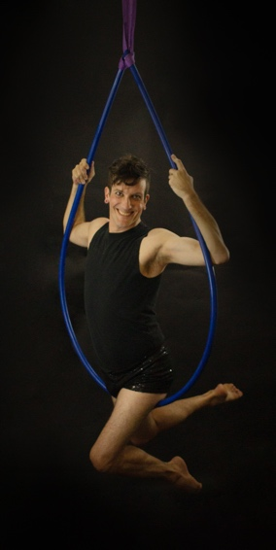
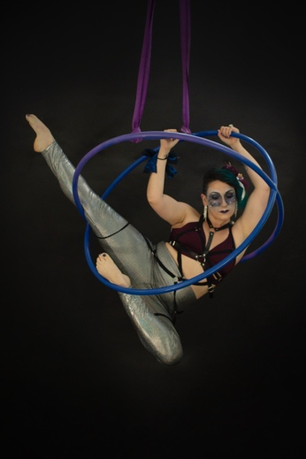
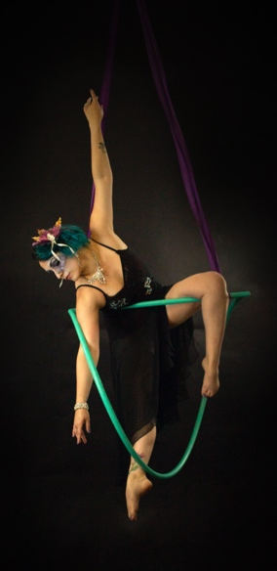
It grew from there…

Slide 12
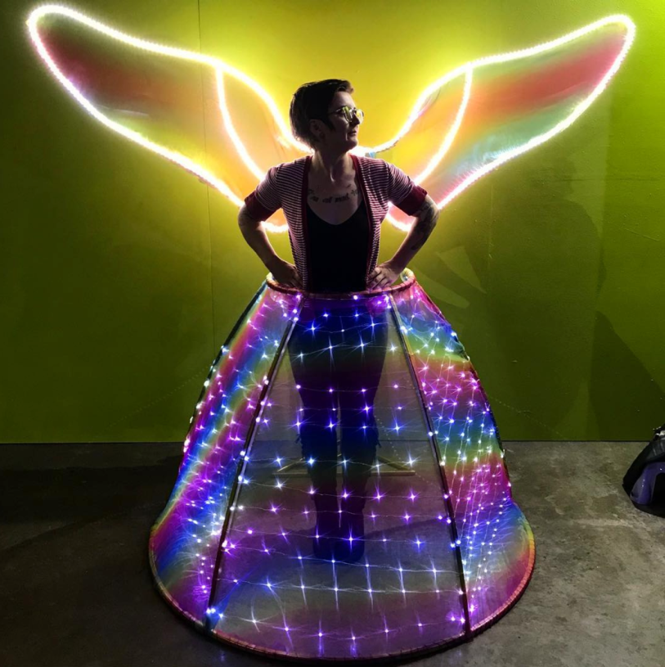
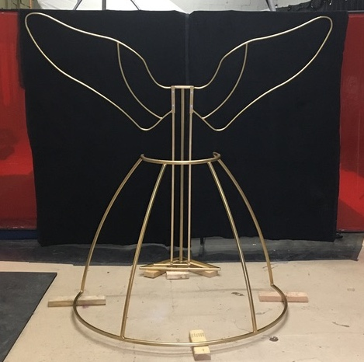
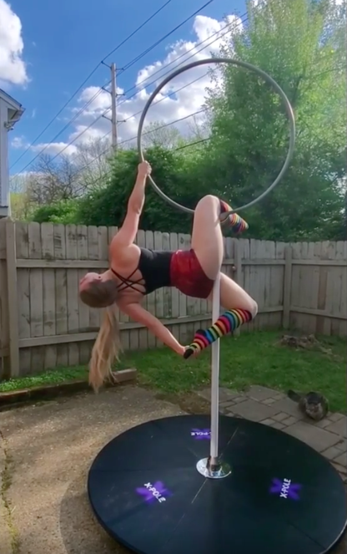
selfie booths,
Lollipops and champagne skirts…

Slide 13
Custom orders
Target Customers NOW
Rentals
Pre-Made
Goods
Aerial Dancers
& Performers
Entertainment
Spaces/Events

Slide 14
Custom orders
Target Customers +3 years
Rentals
Pre-Made
Goods
Aerial Dancers
& Performers
Entertainment
Spaces/Events
At-Home
Consumers

Slide 15
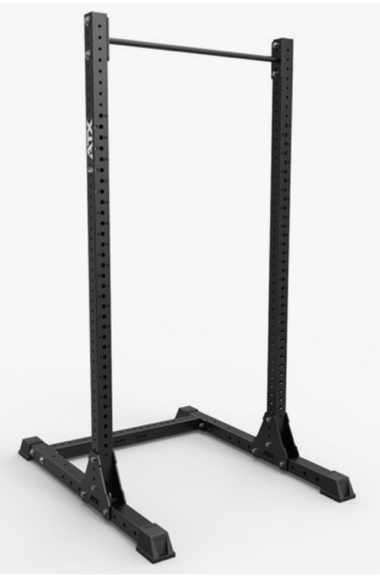
TRAINING AT HOME
Fire dance supplies
Weight bench for home
At-Home Training Equipment

Slide 16
GROWTH
Path
Custom
Orders
Online store
2020
2021
2022+

Slide 17
GROWTH
Path
Sculpture & Small Spaces
Custom
Orders
Online store
Fitness at home
Flow art products
Local rentals
2020
2021
2022+

Slide 18
GROWTH
Path
Large Art event space design
Sculpture & Small Spaces
Larger scale Touring SHOW pieces
Custom
Orders
Online store
Fitness at home
Flow art products
ELECTRONIC
ProDucts
Local rentals
Rental House
2020
2021
2022+

Slide 19
GROWTH
Path
Screen & Electronics Design
Large Art event space design
Sculpture & Small Spaces
Larger scale Touring SHOW pieces
CNC
Bender
Design
team
Destructive
Testing
Improved
tooling
Partnership with Fitness experts
Custom
Orders
Online fulfillment & Services
Online store
Fitness at home
Product line
development
Flow art products
Electronics Team
LED
ProDucts
Local rentals
Weld Scanning
Inspection team
Rental House
2020
2021
2022+

Slide 20
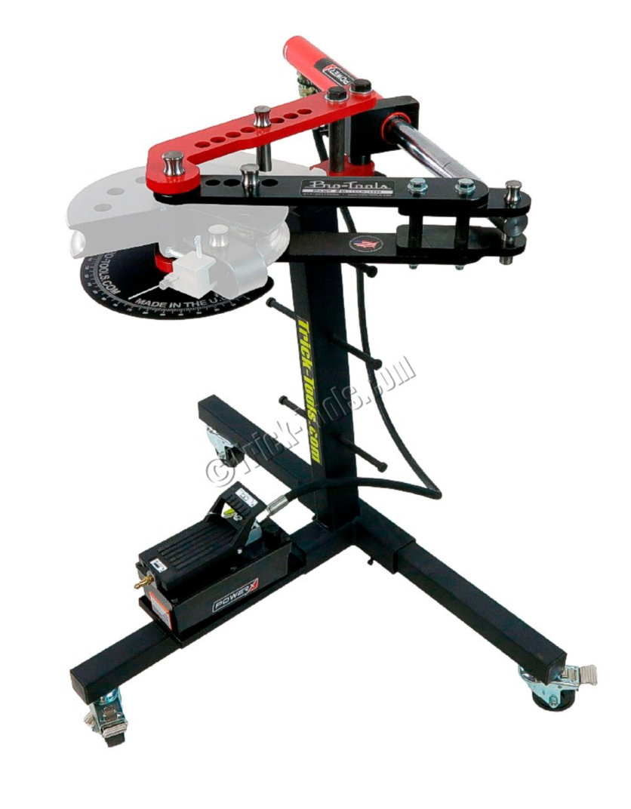

ASK #1: Improved Tooling - BENDER
$2500 with dies

Slide 21
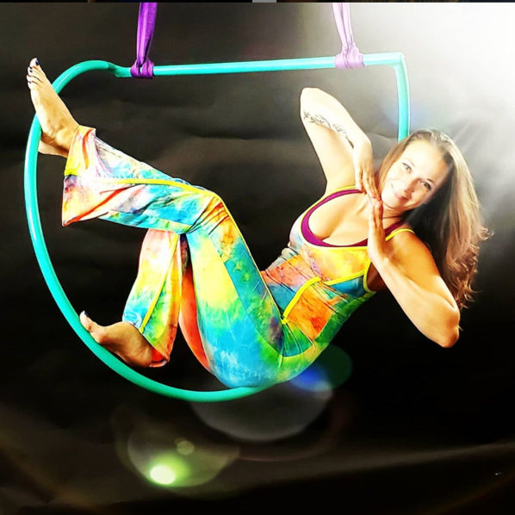
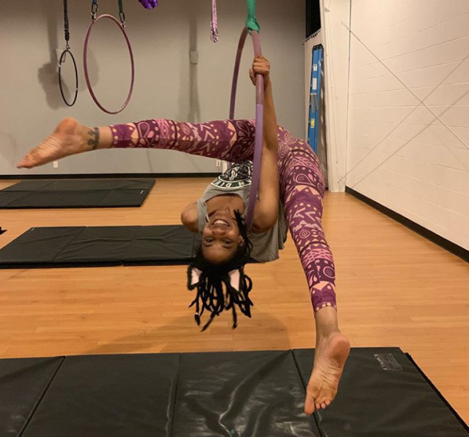
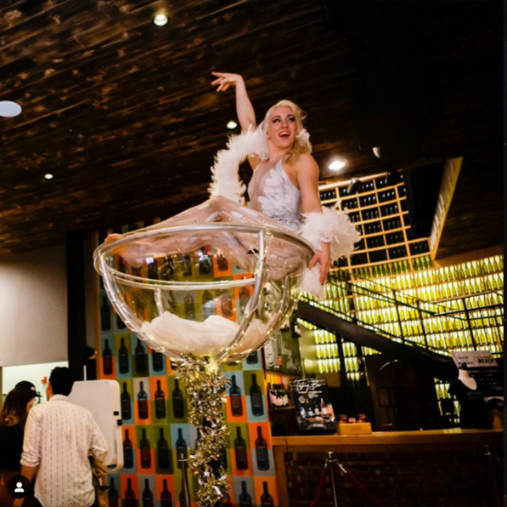
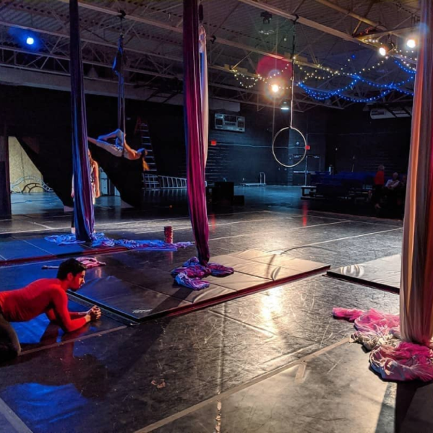
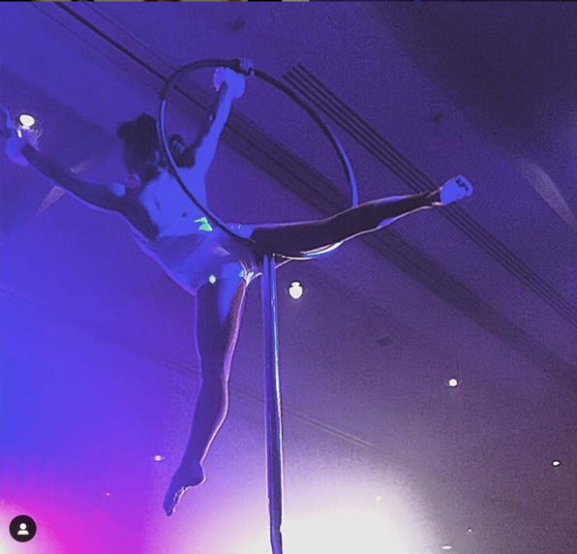
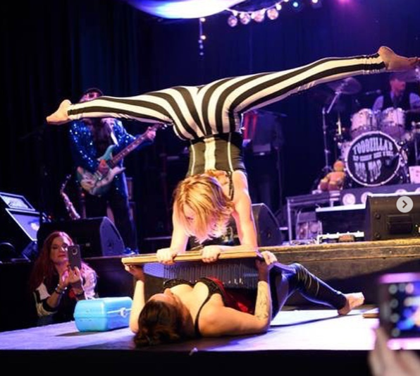
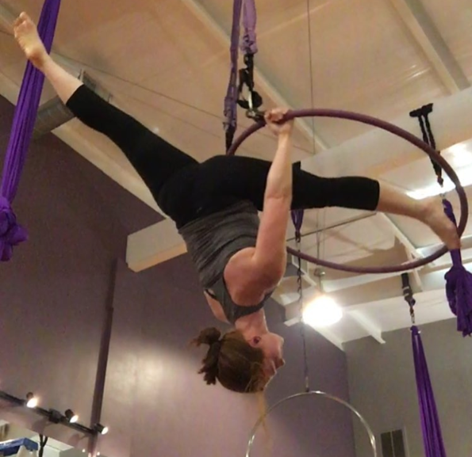
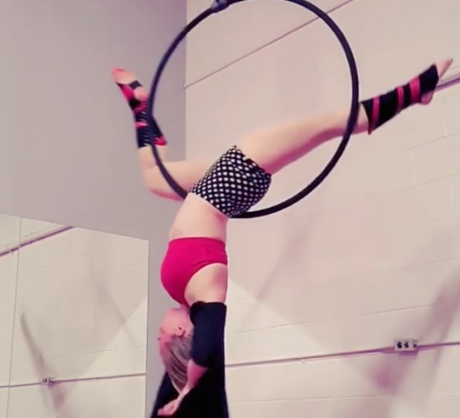
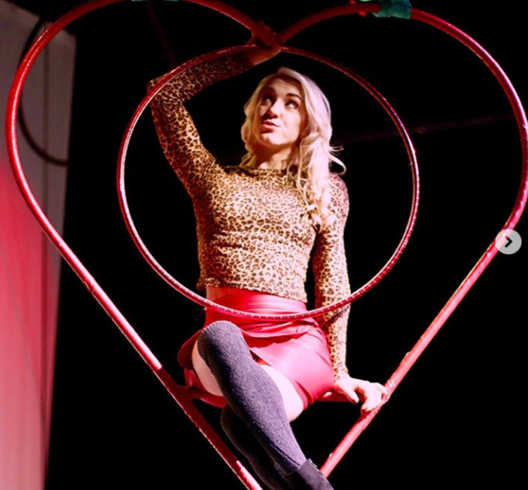
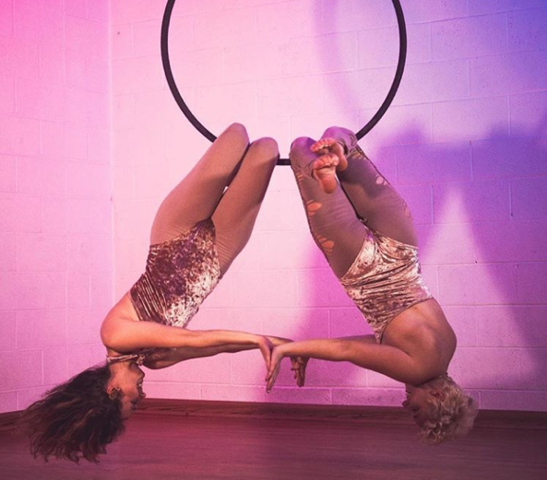
crystalstarr_performer
luceeontheinternet
beyondwingscircus
fallaerialarts
suspendedgravitycircus
Ask #2: Support Local Performers
Hire them • Go to shows • TakE CLASSES
freaklesque_nashville
bad.penny
angela.does.aerial
gracegoodcirque
pyro.glyphics

Slide 22
Photo by Columbus NavigatoR
Photo by OTHERWORLD OHIO
ASK #3: connections
show producers & CREATIVE Event spaces
interstellarapparatus@gmail.com
interstellarapparatusdesign.com

